Slide 1
Metro Vanpool Webinar + Q&A Series
Notes:
BT NOTES | Presenter: Introduce yourself and the moderator. Ask everyone to mute themselves. Callers will be muted at this time. Those participating in the webinar can use the "raise hands" and chat section. This training will be recorded for training purposes. Q&A will be saved until the end.
Ridesharing refers to any form of
traveling other than driving alone, including carpooling, vanpooling,
taking transit, bicycling, and walking.

Slide 2
Agenda
New Metro Vanpool Software Portal and Why
Activating Your Account
Setting Up Your Profile
Reporting
Updating Passenger Lists
How to Pre-Qualify and Apply for a Subsidy
Participation Agreement Tips
Documents and Resources
Error Messages
Q&A
Note: *The following slides are in Mobile View*
Notes:
BT NOTES | https://metrovan.ridematch.info/rp2/Home/Home

Slide 3
New Metro Vanpool Software Portal and Why
New website portal launched July 2020
Reporting and all other procedures made easier
No more paperwork, no scanning, no faxing
Online software helps secure your $600 subsidy!
Mobile app available

Slide 4
New Metro Vanpool Software Portal and Why
What We Had
What We Have Now

Slide 5
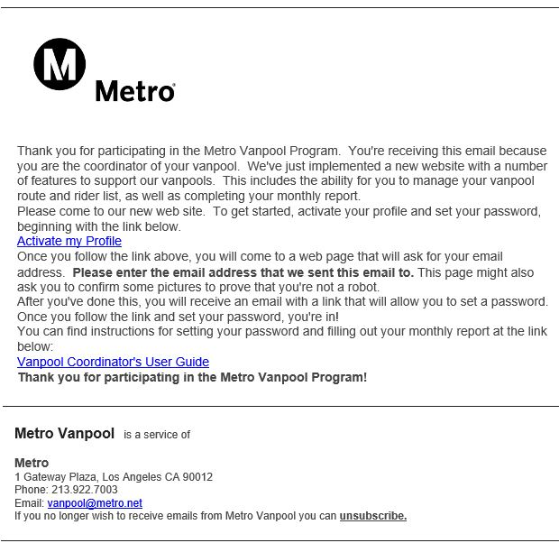
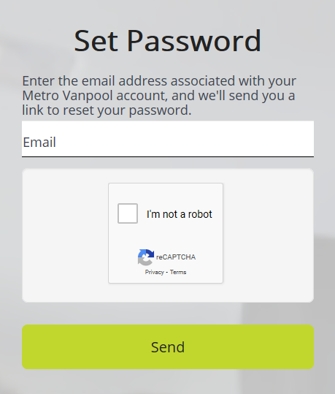
Activating Your Account
1.
2.
Notes:
Add “Set up Profile Next”

Slide 6
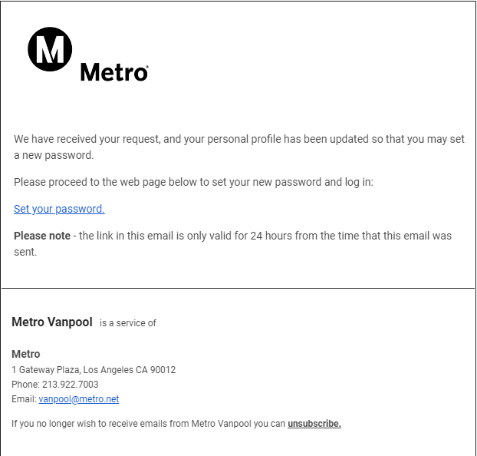
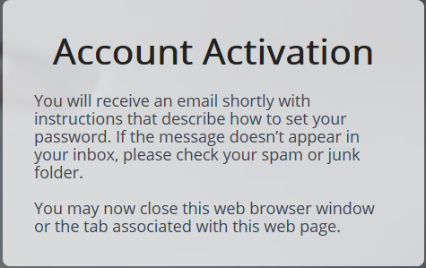
Activating Your Account
3.
4.
Notes:
Add “Set up Profile Next”

Slide 7
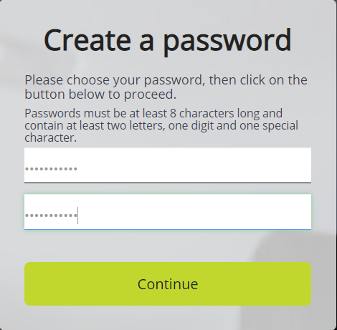
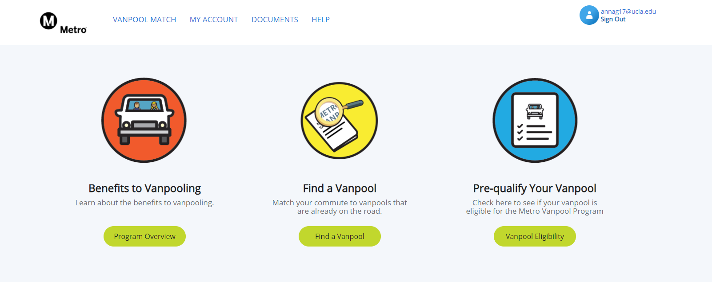
Activating Your Account
5.
6.
*ONCE YOU SEE THIS SCREEN, YOUR DONE!*
Notes:
Add “Set up Profile Next”

Slide 8
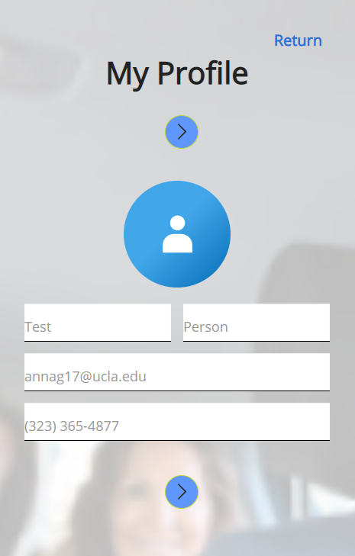
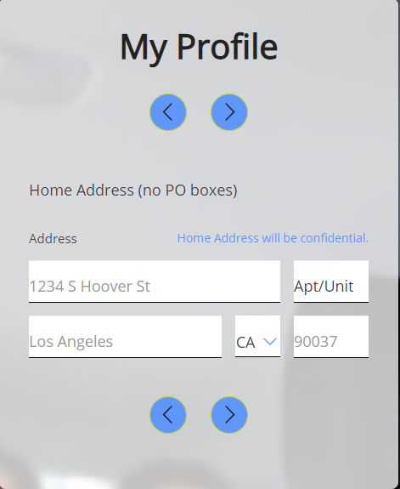
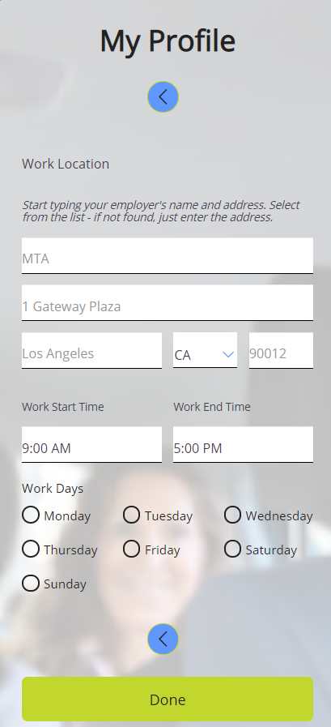
Setting Up Your Profile
1.
2.
3.

Slide 9
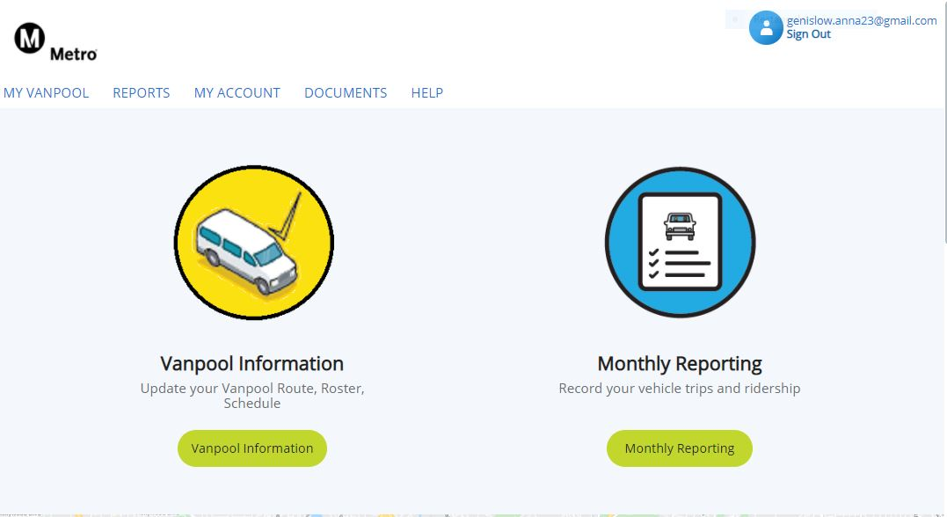
Reporting
Step 1
After you sign in, click Reports or Monthly Reporting

Slide 10
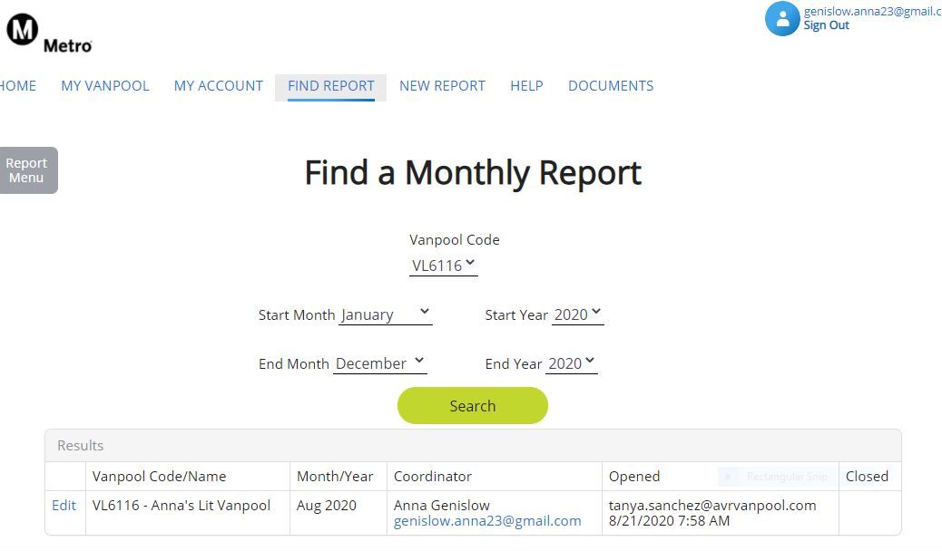
Reporting
Step 2
Click New Report

Slide 11
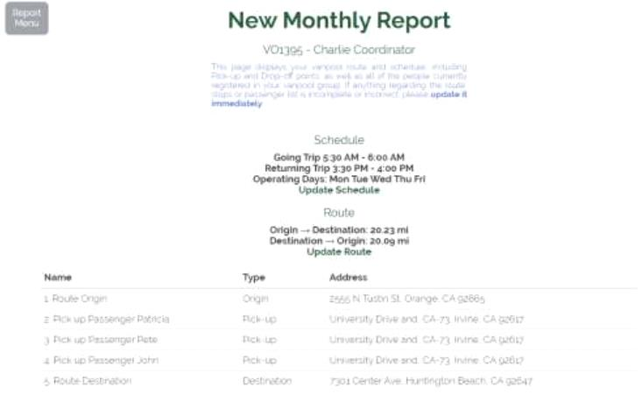
Step 3
Reporting
Make sure all route and passenger information is correct. Then click Create

Slide 12
Step 4
Reporting
Select the first day of operation
(Then you just go day by day each day the van operates)
Notes:
BT NOTES | Explain this is the particpant perspective and that there is an alternative desktop view.

Slide 13
Step 5
Reporting
Fill in each required field
Check who rode in/out

Slide 14
Step 6
Reporting
Input expense and indicate expense type

Slide 15
Step 7
Reporting
Input ending odometer reading
Step 8
Click submit once you see that all information is correct
Notes:
Less on applying, more on reporting
How to get to reporting, more step by step there,
Errors trip them up here
Take out 1 or 2 slides on applying

Slide 16
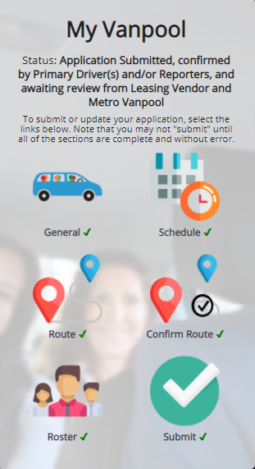
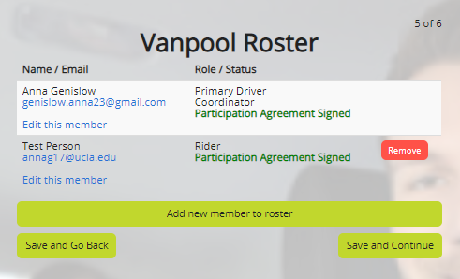
Updating Passenger Lists
1.
2.
Notes:
Make Mobile View

Slide 17
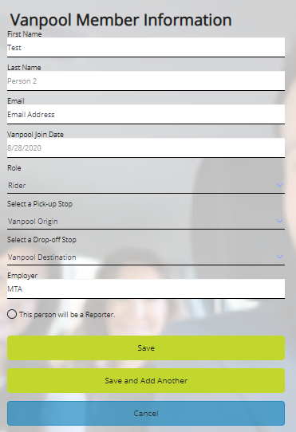
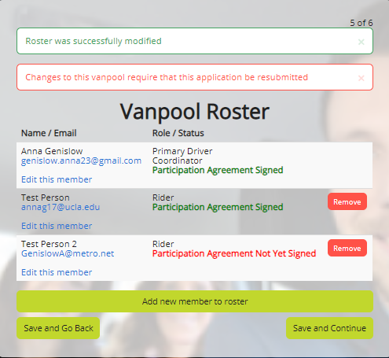
Updating Passenger Lists
3.
4.
Notes:
Mobile View

Slide 18
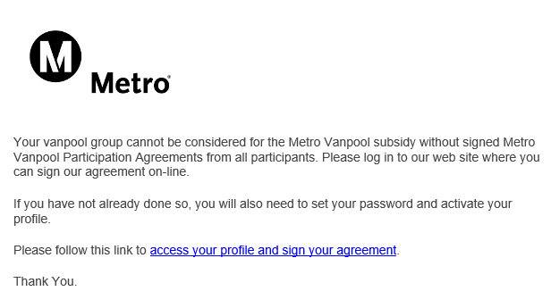
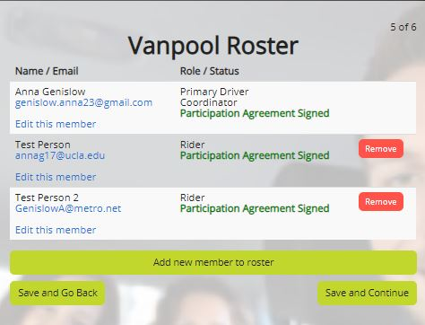
Updating Passenger Lists
5.
6.
*They will be emailed with the above message a request to sign their Participant Agreement before they show up as added on your roster*
Notes:
Mobile View

Slide 19
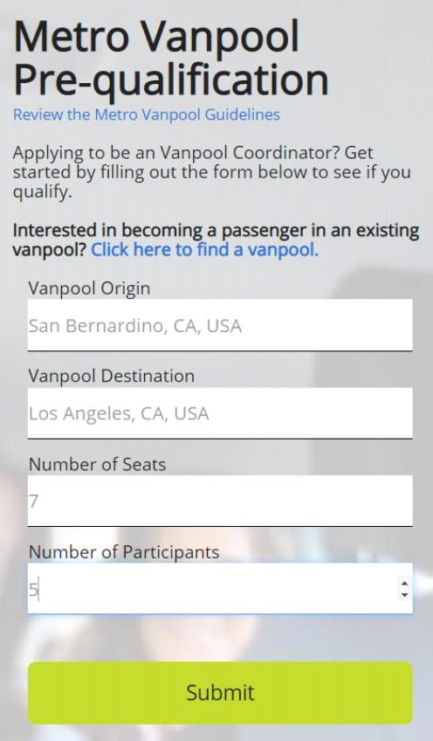
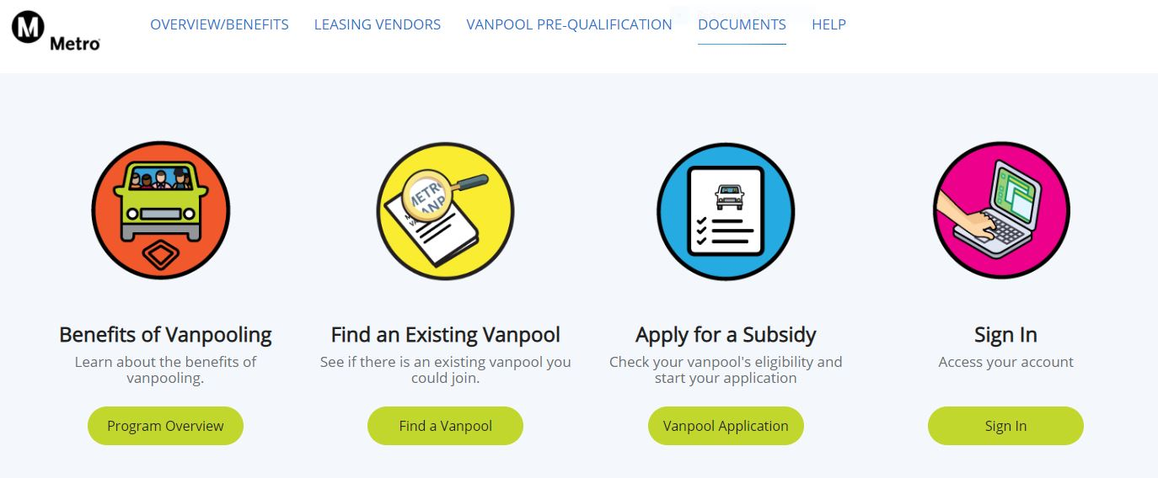
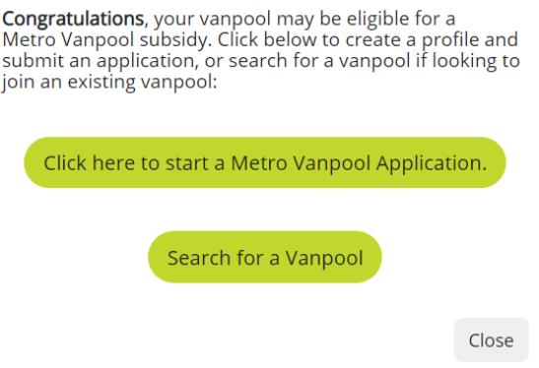
How to Pre-Qualify Your Vanpool and Apply for a Subsidy
Step 1 Pre-Qualifying
Fill out requested information
Notes:
Make it separate topics

Slide 20
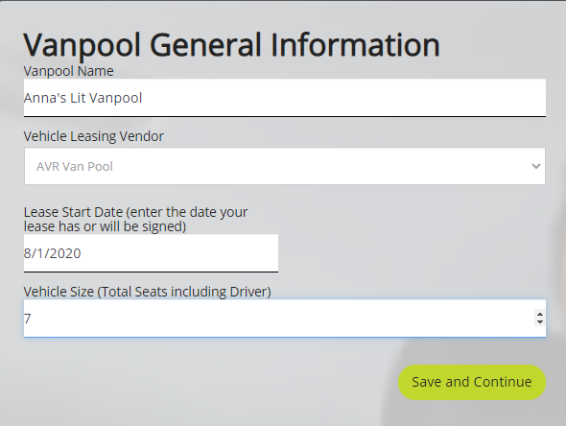
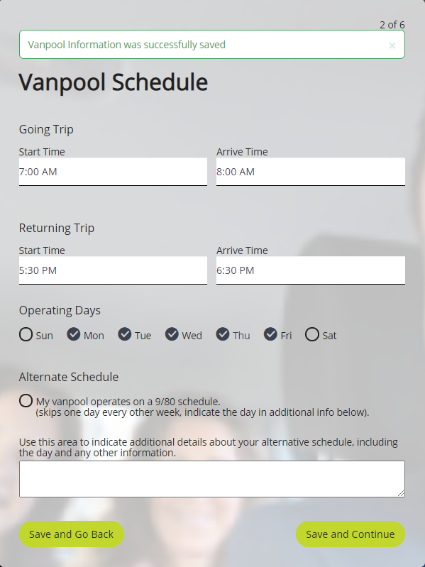
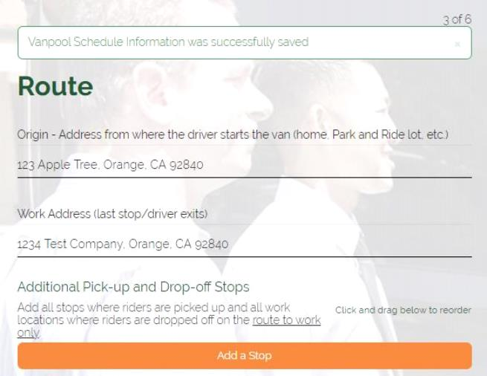
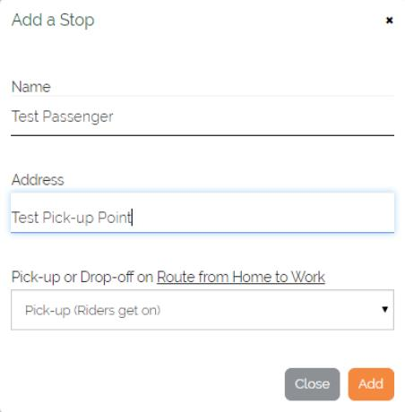
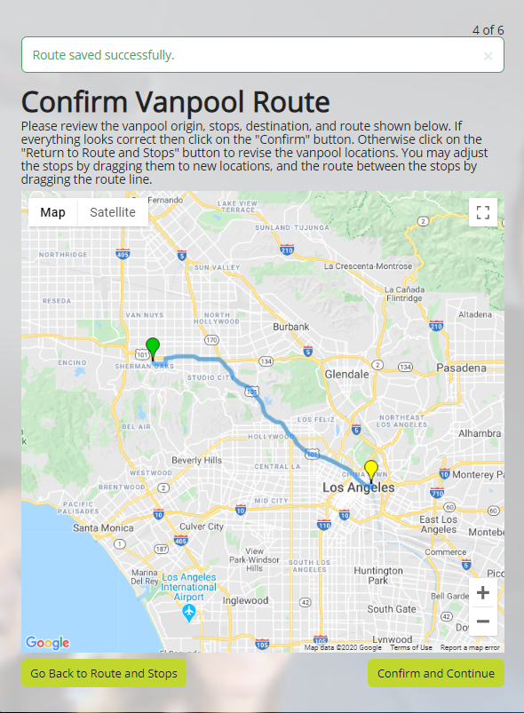
How to Pre-Qualify Your Vanpool and Apply for a Subsidy
Step 2 Applying
Enter vehicle information
Enter schedule
Enter route

Slide 21
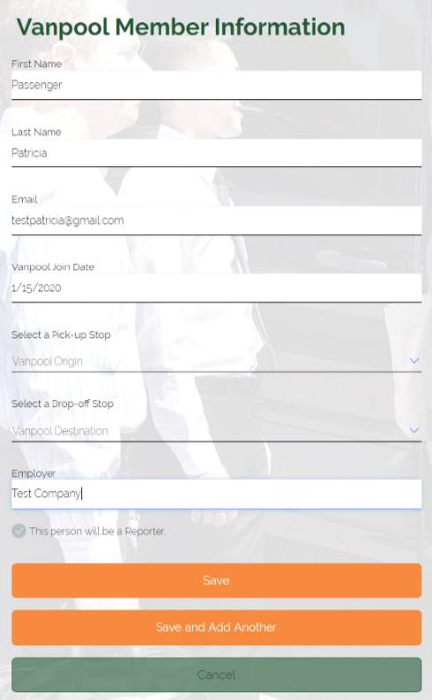
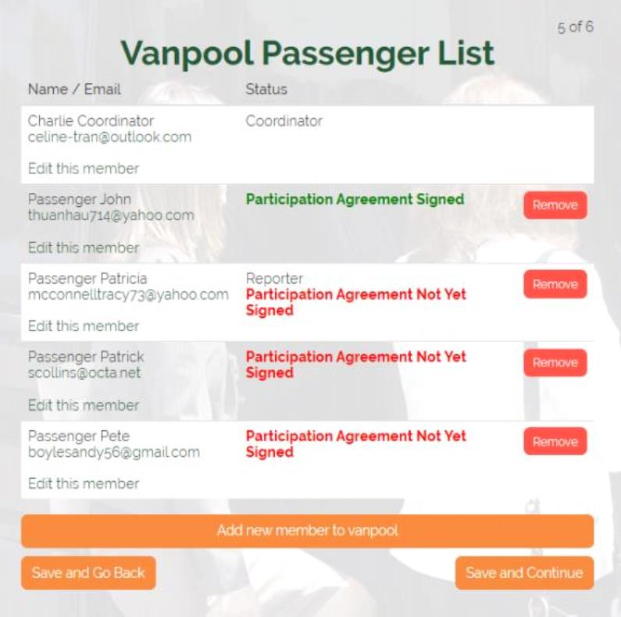
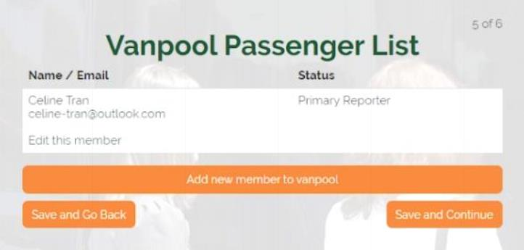
How to Pre-Qualify Your Vanpool and Apply for a Subsidy
Step 3 Applying
Enter Passengers

Slide 22
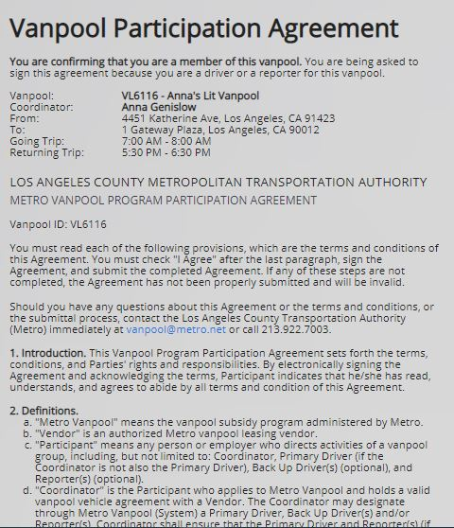
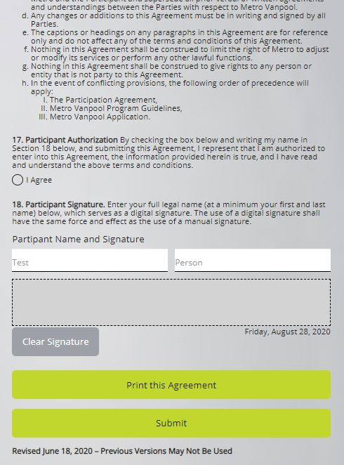
How to Pre-Qualify Your Vanpool and Apply for a Subsidy
Step 4 Applying
Have all the passengers you added sign the Participation Agreement and confirm their pick-up and drop-off locations

Slide 23
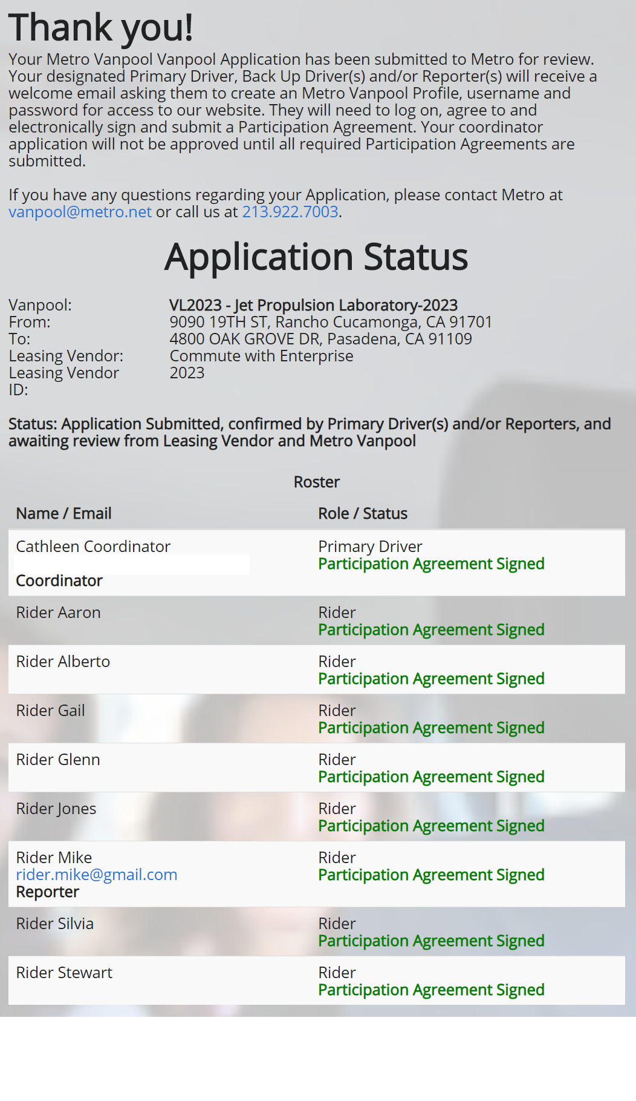
How to Pre-Qualify Your Vanpool and Apply for a Subsidy
Step 5 Applying
Once everyone has signed, your application is ready for review

Slide 24
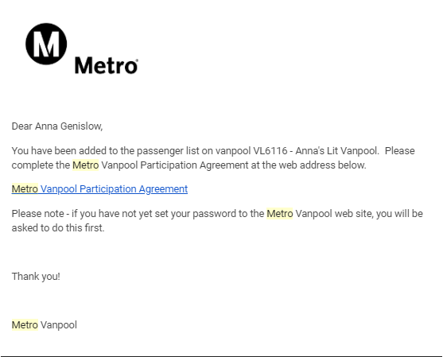
Participation Agreement Tips
A correct and valid email address is needed for the person to receive their participation agreement in their email to then sign. It will look like either of these.

Slide 25
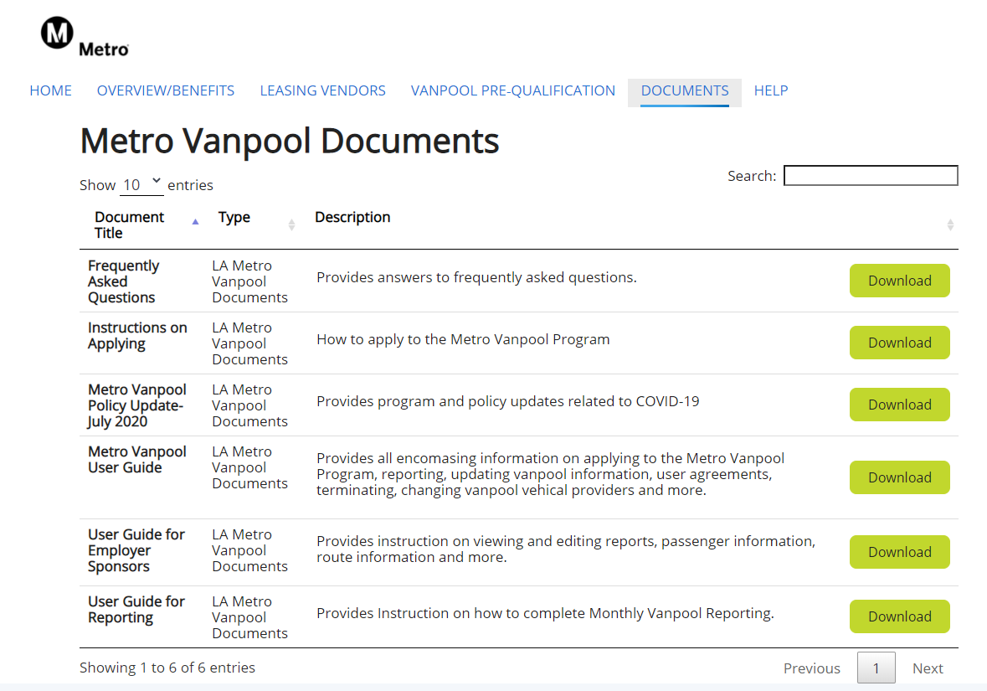
Documents and Resources
View the User Guides, additional upcoming instructional material and COVID Policies under the DOCUMENTS tab.
The slides to this presentation will also be available under the DOCUMENTS tab
Notes:
BT NOTES | This is where you can find the tier and phase splits for the remaining 2020 calendar year.

Slide 26
Error Messages: If you see these…
Check that you are not logged on to your account in more than one window/tab.
Most likely the server timed out or there is miscommunication. Internal authentication issue is a likely hood.

Slide 27
Thank you!

Slide 28
Q&A
Metro Vanpool Help Desk
vanpool@metro.net

